Slide 1

InsightAI Dashboard
Innovative web application for interactive data visualization and analysis with Artificial Intelligence.
Group:
Sohaib Ahmed 21L-5635
Muhammad Hamza Khan 21L-5654
Muhammad Hassan Khalid 21L-5692
Supervisor:
Muhammad Zeeshan Nazar

Slide 2

Problem Statement
Complex Applications
Technical Barriers
Costly Solutions
Limited flexibility hinders data exploration.
Non-technical users struggle with analysis tools.
Extracting meaningful insights is challenging.

Slide 3




Goals Achieved
File Controls
Authentication
Efficient handling of file uploads, storage
and format compatibility.
Secure user registration and login system to
manage access and ensure data privacy.
Home Page
Dashboard
Intuitive starting point providing seamless
navigation across application features.
Central hub displaying key insights and user-
customized data visualizations.

Slide 4




Goals Achieved
Data Table Page
Data Visualization Agent
Organized representation of uploaded datasets
for easy viewing and interaction.
AI-driven insights enabling users to generate
advanced visual analytics.
Chart Rendering
SQL and Mermaid Diagram Agent
Dynamic creation of charts and graphs for clear
data representation.
Tool for executing SQL queries to analyze datasets and automatically generating flowcharts and diagrams for structured visualization.

Slide 5
Future Goals
1
Research Assistant Agent
Develop an assistant capable of summarizing data, generating insights and answering user queries intelligently.
2
Data Cleaning Agent
Implement an agent to automate the detection and correction of inconsistencies and missing values in datasets.
3
Business Analytics Agent
Build an agent tailored to deliver advanced business analytics, including trend analysis and decision support.
4
Multi-File Integration in AI
Enable the application to support seamless integration of multiple files.

Slide 6
Future Goals
5
Application Customization
Introduce extensive customization options, enabling users to personalize workflows, dashboards
and data visualization styles based on their specific needs
6
Dataset Saving
Provide functionality for users to save their datasets.
7
Advanced and Custom Analysis Features
Enhance the analytical capabilities of the application by adding advanced features like correlation analysis
and tailored analytics to meet diverse user requirements.
8
Enhancing the User Interface
Enhance the user interface to improve usability and overall user experience.

Slide 7
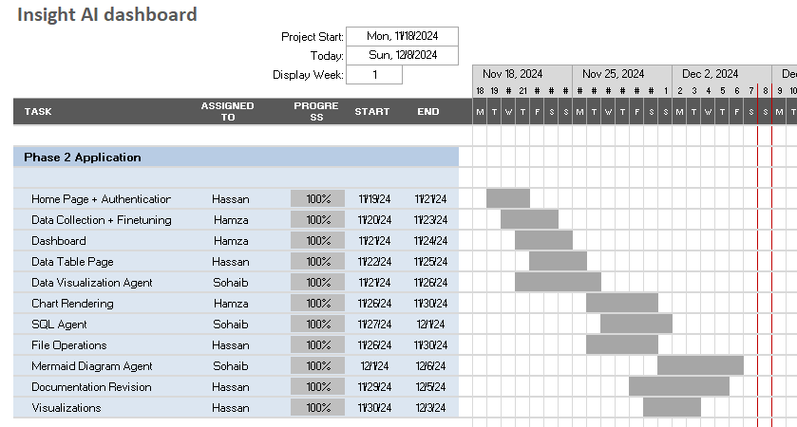

Slide 8
Conclusion: Transforming Data Analysis
Innovation
Empowerment
Future-Ready
Bridging gap between complex data and user-friendly analysis.
Enabling all users to gain valuable data insights.
Positioned for growth with AI and visualization capabilities.

